Slide 1
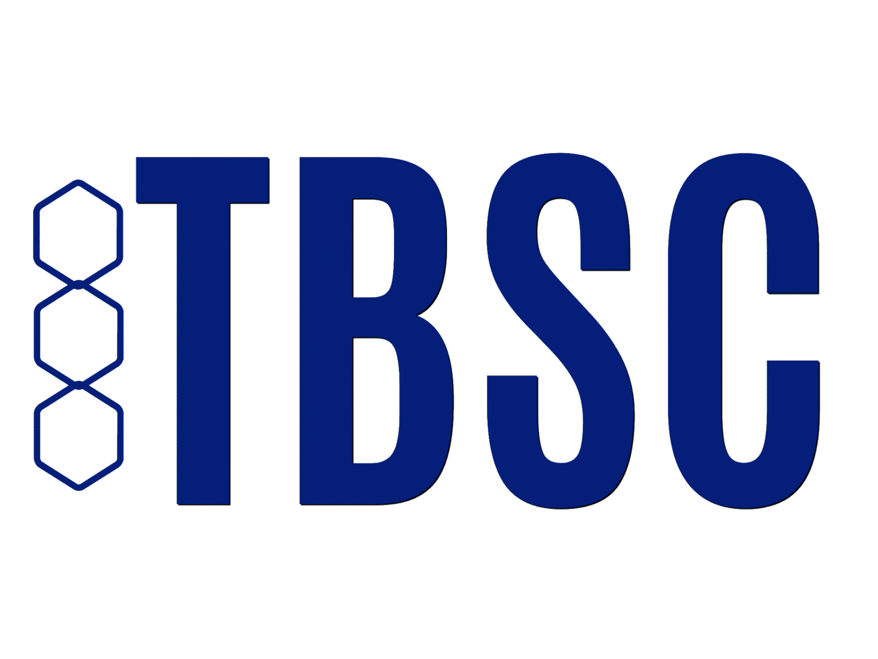
Pharmacy
Case Study
Performed using Smarter SaaS reporting
by The Business Software Centre
ABOUT PHARMACY CLIENT
Case Study kEY FINDINGS
The pharmacy assists with customer illness and health concerns, using Microsoft 365 as an internal communication tool between departments and staff.
Microsoft 365 subscriptions had been deployed to full time/ part time staff with variable levels of usage. As staff left and joined it was difficult to keep pace with the JML process as it related to Microsoft 365 subscriptions.
The pharmacy recognised there was a potential issue growing with alignment of subscriptions with users, engaging TBSC to run a 365 Health-check on their level of optimisation of Microsoft 365 subscriptions
Likewise, the pharmacy wanted to insure security of sensitive customer and business data.
The Challenge ? The pharmacy needed to manage and track accurately the subscriptions of current and past employees ranging from full-time, part-time, and temporary. Likewise, track security of business and customer data.
The Problem? The engineering consultancy did not have systems in place for either manual or automated tracking of Microsoft 365, losing ROI, risking security and
The Solution? The engineering consultancy was encouraged to automate Microsoft 365 reporting for the year to gain best practices, increase ROI, and recognise unused Microsoft 365 licenses.
The Results? Benchmarking with TBSC’s 365 Health-Check, the analysis discovered 199 employees in non compliance along with over 1,000+ employees with high security risk. TBSC's recommendation: Improved leavers process to restrict access for past employees
https://www.businesssoftwarecentre.com/
info@businesssoftwarecentre.com
Notes:
Type your notes

Slide 2
aBOUT SMARTER SAAS
Automated 365 Optimization
Smarter SaaS for M365 is a cloud-based Software Asset Management solution that optimises Microsoft 365 subscriptions. Smarter SaaS for M365 automatically recommends how to reduce IT costs whilst finding the best Microsoft M365 subscriptions for every user. We offer a Health-Check version of Smarter SaaS which is done in the first month of the subscription or offered as a one-off.
SMARTER SaaS FOR MICROSOFT 365 HEALTH CHECK OBJECTIVE:
Automated 365 optimisation
Identifies and automates cost optimisation
Indicates low levels of user adoption of key MS 365 apps such as Teams
Shows usage levels by individual user
Aligns the training and optimisation process
Automates actions and adoption processes
Measures usage improvements
Ensures high levels of interactive working and ROI
Is G-Cloud approved
Is Microsoft approved as an ISV solution
The 365 Health-check provides a detailed cost optimization assessment and efficiency benchmark rating for the Microsoft 365 estate.
The Smarter SaaS for Microsoft 365 analysis provides a usage efficiency rating and benchmarking against industry standards.
TERMONOLOGY
Reharvesting is taking an inactive subscription and resdistributing to an active user. With a click of a button, Smarter SaaS does this automatically. The Optimisation feature takes the current license and provides optimisation options. This helps clients ensure the full and efficient use of the licenses they are paying for. Surplus is when there are more subscriptions purchased than being used. The Compliance feature keeps clients one step-ahead of remaining compliant with licensing agreements. Clients will have all the data needed to see where applications are installed and whether you are over or under your license agreement limits.
Notes:
Add note to this slide

Slide 3
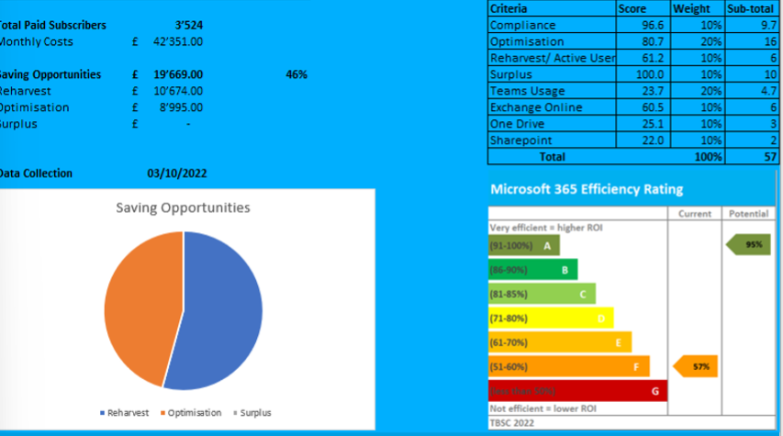
dATA aNALYSIS shows
Potential savings, cost reduction options
No recycling of leavers’ subscriptions
Security issues: compliance
Usage optimisation potential
Need for app adoption
Possible downgrades
Health-check outcomes
Potential Costs Optimisation of 46% of annual subscription cost​
Improve Teams Usage from 23.7% to 95%​
Increase OneDrive and SharePoint usage to 95%​
Potential ROI from using Smarter SaaS 365 = 22x
Cancel access to unused subscriptions where staff have left the organisation​
Results
Key criteria relating to usage efficiency reveals areas where improvements are required and best practices can be implemented.
Smarter SaaS for Microsoft 365 measures efficiency levels and allocates a composite score out of 100 to benchmark efficiency, providing a comparison against a best practice position.
The current Health-check score is 57%. By implementing best practices, the client can reach the optimisaion goal of 95%.
23% of users are not using Microsoft Teams . By proper training and support the usage can increase and boost ROI.
https://www.businesssoftwarecentre.com/
Notes:
Add note to this slide

